Slide 1
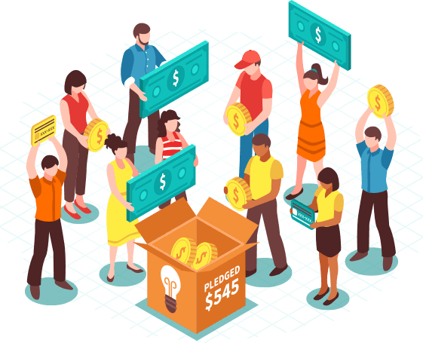
TRANSPARENT FUNDING PLATFORM USING BLOCKCHAIN
Team members
K. Santhosh Kumar 2451-20-733-135
J. Jayanth 2451-20-733-137
Guide
Subhashini Pallikonda
Assistant Professor, CSED

Slide 2
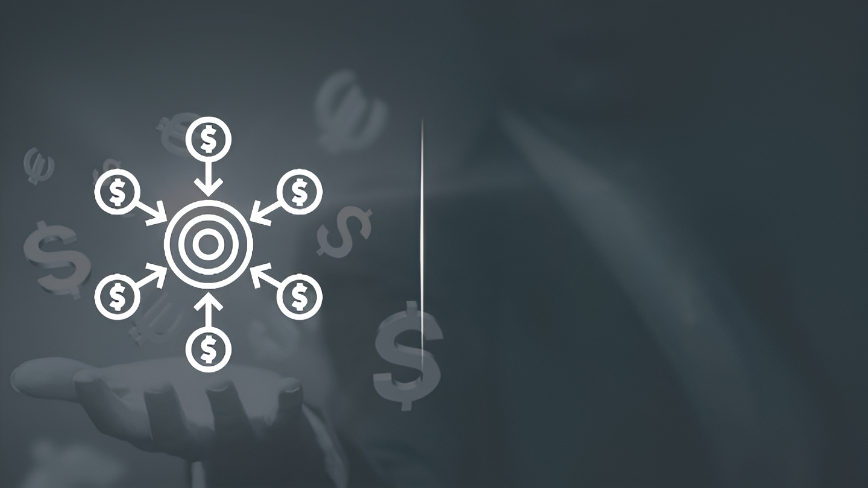
TRANSPARENT FUNDING USING BLOCKCHAIN
Team members
K. Santhosh Kumar 2451-20-733-135
J. Jayanth 2451-20-733-137
Guide
Dr. Subhashini Pallikonda
Assistant Professor, CSED

Slide 3






PROBLEM STATEMENT
In the current centralized funding system, there are several limitations
Inefficiency
Multiple intermediaries involved in processing transactions and taking fees. This can slow down the process of funding projects and organizations.
Limited accessibility
Traditional funding platforms often have restrictive requirements for participation, making it difficult for individuals and with limited resources to access funding.
Lack of transparency
Making it difficult for investors and donors to track the flow of funds and ensure that their contributions are being used as intended.

Slide 4
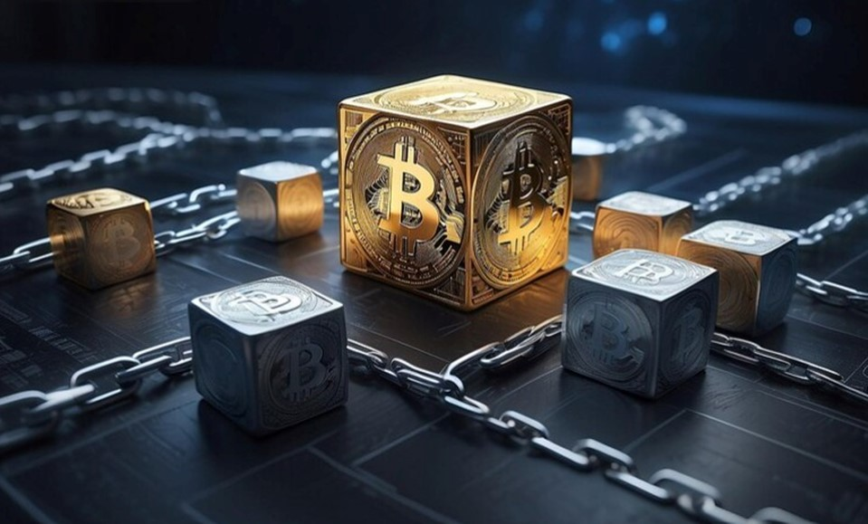

SCOPE OF THE PROJECT
Decentralized ledger records, agreement system, and self-executing contract framework development.
Create user-friendly interface for investors and beneficiaries, ensuring intuitive experience.
Enforce robust security for platform safeguarding user funds and data.
Ensure platform aligns with all relevant laws and regulatory requirements.
Create tools enabling investors to manage and track investment portfolios efficiently.

Slide 5
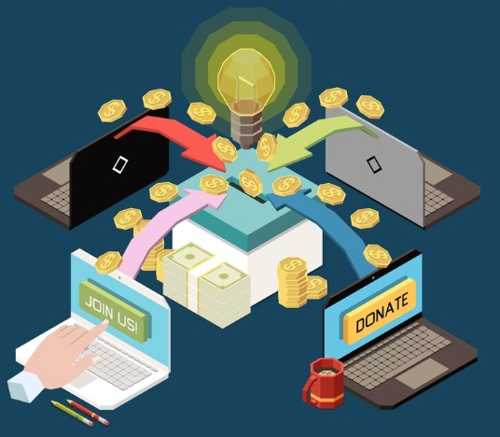
ABSTRACT
Blockchain based crowdfunding platform have the potential to revolutionize the crowd funding industry by making it more efficient, transparent, and secure. Blockchain technology can provide a decentralized and tamper-proof platform for crowdfunding. which can help to build trust and confidence among investors, donator, project creator, fundraiser. This platform will leverage blockchain technology to ensure decentralization. smart contract optimization. Overall, this project aims to democratize access to funds and make crowd funding more inclusive and accessible to everyone.

Slide 6
LITERATURE SURVEY
Ref no | PAPER TITLE | AUTHOR | PUBLISHED BY | PUBLISHED ON | DESCRIPTION
[1] | Building a Blockchain-Based Decentralized Crowdfunding Platform for Social and Educational Causes in the Context of Sustainable Development | Bogdan Tiganoaia and George-Madalin Alexandru | MDPI | 22 NOV 2023 | This paper explores blockchain integration in a decentralized web3 app for transparent educational donations. Highlighting smart contracts and Polygon's scalability, it addresses security challenges, emphasizing the transformative impact on SDGs and charitable donations.
[2] | A Transparent , Distributed & Secure Crowdfunding platform based on Blockchain | Vinita Tiwari, Sam Goundar, Karri Babu Ravi, Basant Agarwal Priyanka H | Springer, Research gate | 4 OCT 2023 | Blockchain-powered crowdfunding ensures transparency, accountability, and security, addressing fund diversion concerns. Decentralization enhances accountability and counters monopoly, fostering improved business scalability.

Slide 7
LITERATURE SURVEY
Ref no | PAPER TITLE | AUTHOR | PUBLISHED BY | PUBLISHED ON | DESCRIPTION
[3] | Blockchain based Crowdfunding using Ethereum Smart Contract | Dipali Pawar, Sanket Sangle, Aditya Muley, Siddhesh, Ruhinaaz Shaikh | IJRASET | MAY 2023 | The paper explores Blockchain-based crowdfunding's potential in addressing traditional funding challenges, emphasizing transparency, security, and efficiency. Integration with Ethereum smart contracts revolutionizes fundraising.
[4] | Fund Crypt using Sha-256 & pos alg | P.B. Kumbharkar, Geetank Asati, Aditya Valekar, Rushikesh Palaskar, Satyam Yenegure | IEEE | 19 JUL 2023 | Study explores blockchain in crowdfunding, addressing challenges. Blockchain's decentralization, transparency, and smart contracts enhance crowdfunding. Valuable insights for entrepreneurs, investors, and developers.

Slide 8
LITERATURE SURVEY
Ref no | PAPER TITLE | AUTHOR | PUBLISHED BY | PUBLISHED ON | DESCRIPTION
[5] | Crowdfunding Dapp | Chethan S, Rohan P, Roopashree CS | IRJMETS | 07 JUL 2023 | Paper introduces blockchain crowdfunding for large projects, emphasizing secure, transparent decision-making. Positive survey results affirm platform's potential to enhance transparency, trust, and security.
[6] | Blockchain-based Distributed Secure Crowdfunding and Decision-MakingPlatform for Large-scale Business Projects in Public and Private Sectors | Malithi mithsara, T M K K Jinnasena | Research gate | SEP 2020 | The article proposes a decision-making platform for large-scale business projects. It addresses funding challenges, trust issues, and decision-making transparency, utilizing Ethereum smart contracts to enhance security, reliability, and community involvement in project investments.

Slide 9
REFERENCES ANALYSIS
[1] This article explores blockchain's role in transparent and efficient educational donations, aligning with our decentralized funding platform.
[2] This article discusses the importance of transparency for building trust in crowdfunding and its role in boosting investor confidence.
[3] Implementing these references into our project will improve theoretical foundation and also align it with existing research in the field of blockchain-based crowdfunding.
[4] This article provides significant importance on traditional crowdfunding platforms face various challenges, including high fees, lack of transparency, and vulnerability to fraud.
[5] This reference offers insights on smart contracts, user experience, and strategic partnerships for successful implementation.
[6] These references cover aspects like platform revolution, Ethereum, blockchain in government, and a comprehensive review on smart contracts

Slide 10



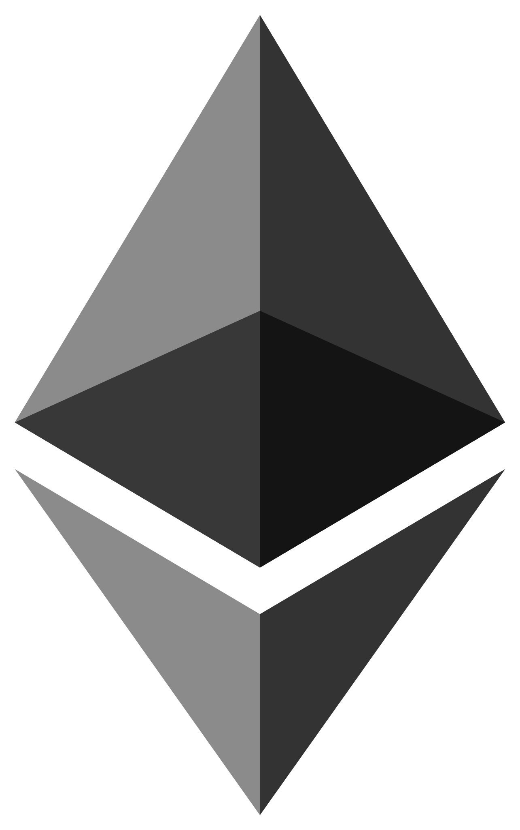




DEVELOPMENT ENVIRONMENT
Ethereum
Solidity
Ganache
Metamask
Next JS
React
Node JS

Slide 11
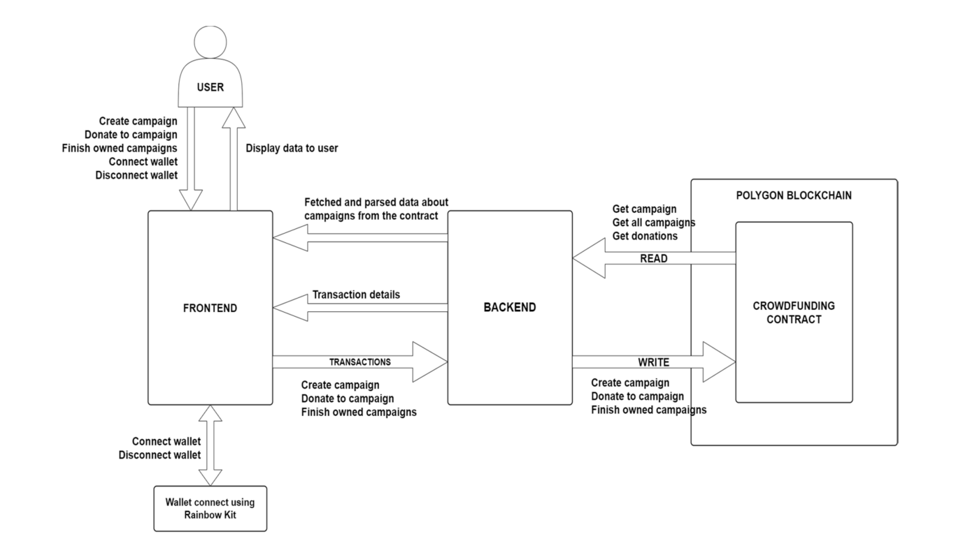
SYSTEM ARCHITECUTRE

Slide 12
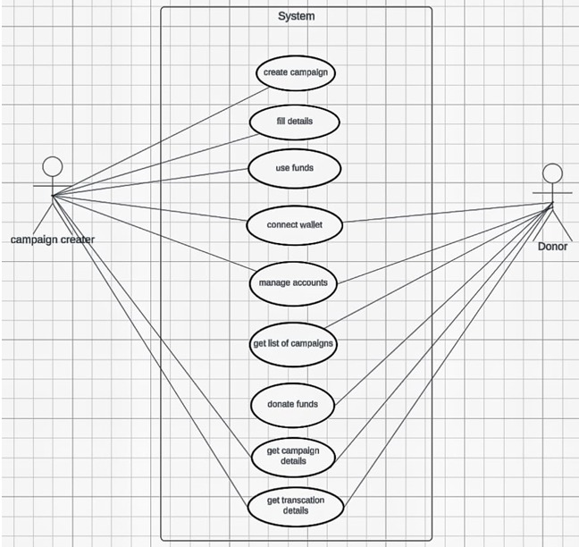
USE CASE DIAGRAM

Slide 13
Start
Connect wallet
Create Campaign
Fill Campaign Information
Fill Contract Balance
Get User Donation per Campaign
Get List of Donations per Campaign
Get List of Transactions per Campaign
Use Funds
End Campaign
End
Start
Connect wallet
Get List of Campaigns
Get Campaign Information
Get Contract Balance
Get User Donation per Campaign
Get List of Donations per Campaign
Get List of Transactions per Campaign
Donate to Campaign
End
FLOW CHART

Slide 14
MODULE DESCRIPTION
CONTRACT CAMPAIGNFACTORY & CONTRACT CAMPAIGN
Funding platform with two contracts: CampaignFactory for creating campaigns and Campaign for managing individual campaigns. Users can create campaigns, specifying details like title, required amount, and images. Contributors can donate funds to campaigns, with received amounts displayed, and successful campaigns' details logged in events. Metamask will connect the wallet through frontend
HARDHAT CONFIG
This Hardhat configuration file sets up a development environment for Ethereum smart contract development. It includes tasks to print Ethereum accounts, utilizes the Waffle testing library, and supports the Polygon network. Private key and network details are sourced from environment variables, enhancing security. Solidity version 0.8.10 is specified for contract compilation.
@type import('hardhat/config').HardhatUserConfig
module.exports = {
solidity: "0.8.19",
};
#npx hardhat init – for installation

Slide 15
MODULE DESCRIPTION
DEPLOY
This JavaScript script, using Hardhat, deploys the "CampaignFactory" smart contract to an Ethereum network. It obtains the contract factory, deploys the contract, and prints the deployed contract's address. Error handling is implemented to log any issues during deployment, ensuring a smooth deployment process for Ethereum smart contract development.
const CampaignFactory = await hre.ethers.getContractFactory("CampaignFactory")
const campaignFactory = await CampaignFactory.deploy(); await campaignFactory.deployed();
DOTENV
dotenv is a Node.js module commonly used to load environment variables from a .env file into process.env. It helps manage configuration settings, such as API keys or sensitive information, in a project by storing them in a separate file, usually named .env
# require('dotenv').config({ path: './.env.local' }); is used to load environment variables from a file named .env.local. The contents of this file typically include key-value pairs in the format KEY=VALUE, and dotenv ensures that these values are accessible through process.env in the Node.js application.

Slide 16
MODULE DESCRIPTION
WALLET
This module represents a component dedicated to displaying wallet-related information, such as the user's address and balance. It serves as a crucial element for users engaging with blockchain-related functionalities
COMPONENTS
Styled Components is a JavaScript module (or package) that you can install and use in your projects. It is available as a package on the npm registry. You can install it using a package manager like npm or yarn. import styled from "styled-component “
const Button = styled.button`
background-color: ${(props) => (props.primary ? 'blue' : 'white')};
color: ${(props) => (props.primary ? 'white' : 'black')};
DASHBOARD AND INDEX
Dashboard and Index: These modules represent distinct pages or views within the application, each serving specific purposes and functionalities. The dashboard module may provide a centralized hub for users to monitor campaign progress, manage contributions, and access relevant information. The index module, often
serving as the application's homepage or landing page, may offer an overview of available campaigns, featured content, or navigation options to guide usersthrough the application experience.

Slide 17
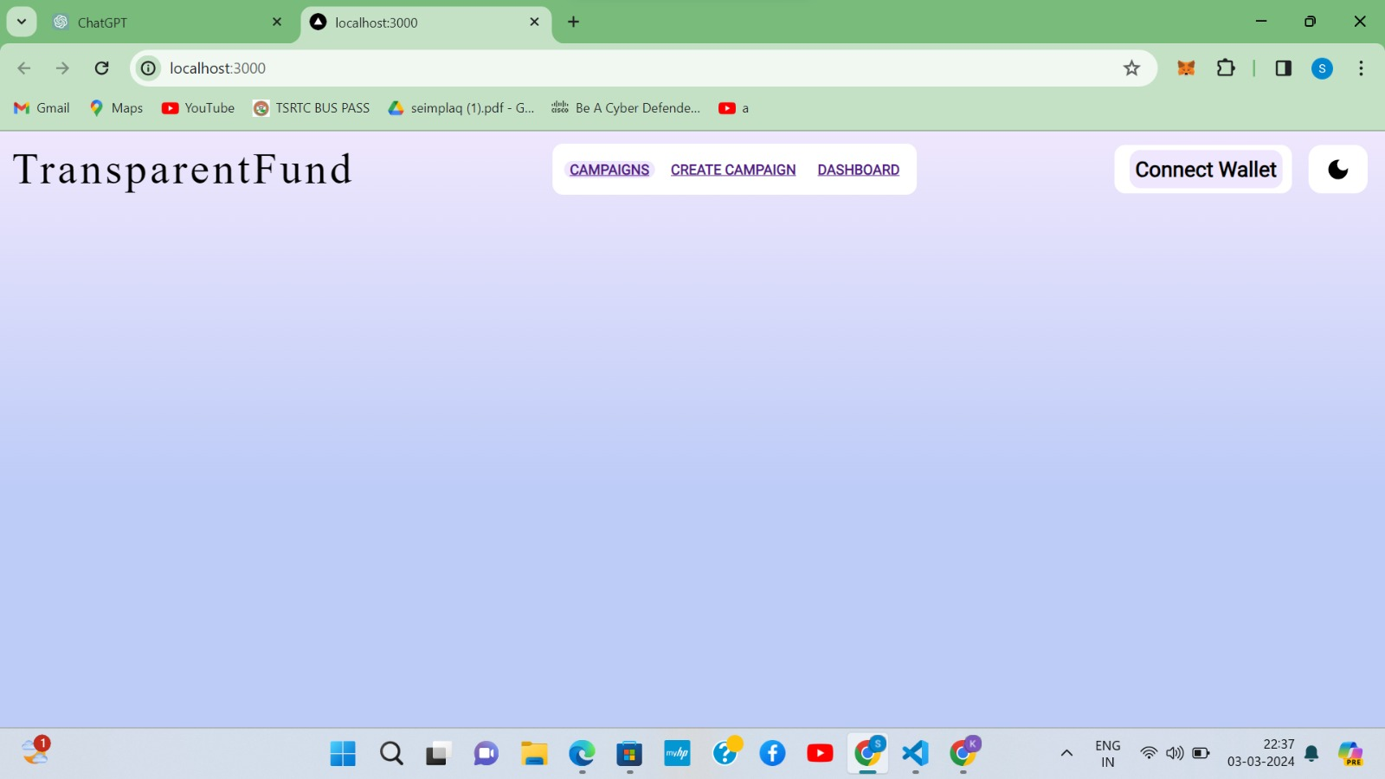
RESULTS/SCREENSHOTS
HOME PAGE

Slide 18
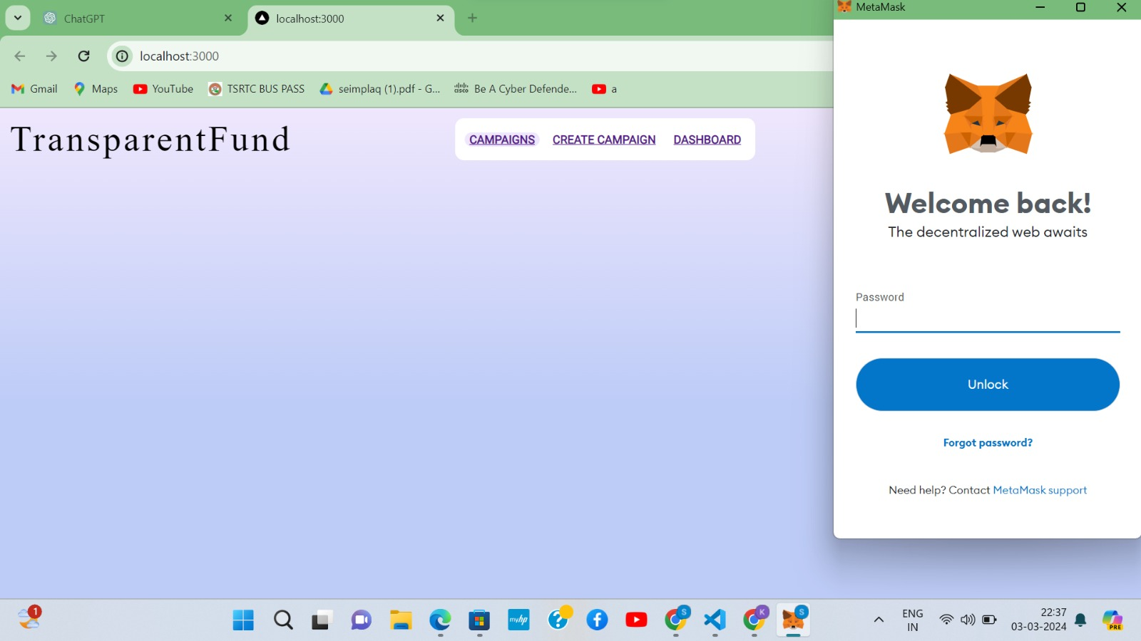
CONNECTING THE METAMASK WALLET

Slide 19
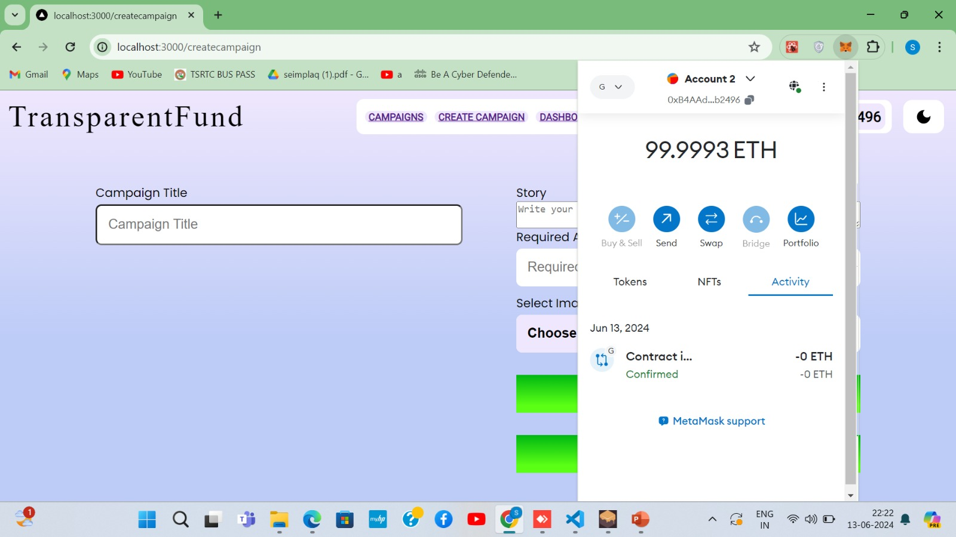
INFO OF YOUR METAMASK WALLET

Slide 20
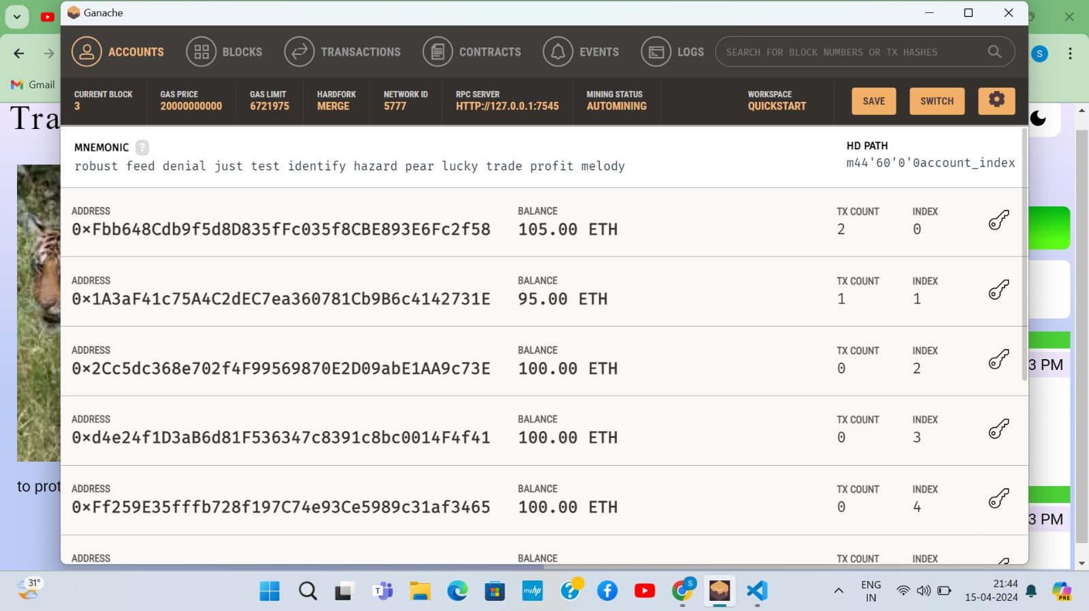
GANACHE CONNECTION

Slide 21
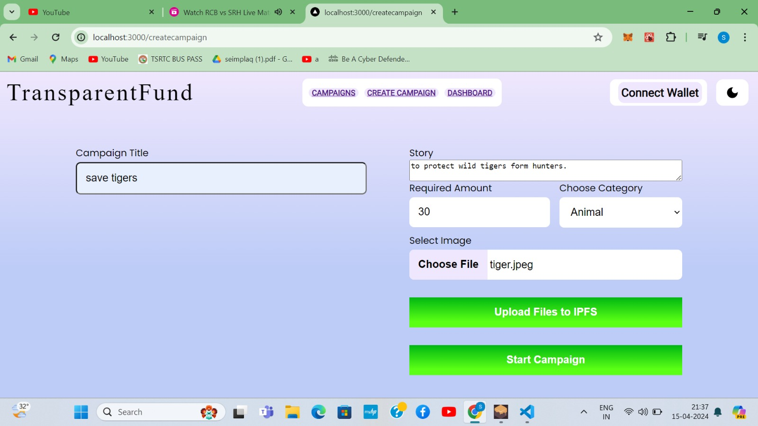
CREATING A CAMPAIGN

Slide 22
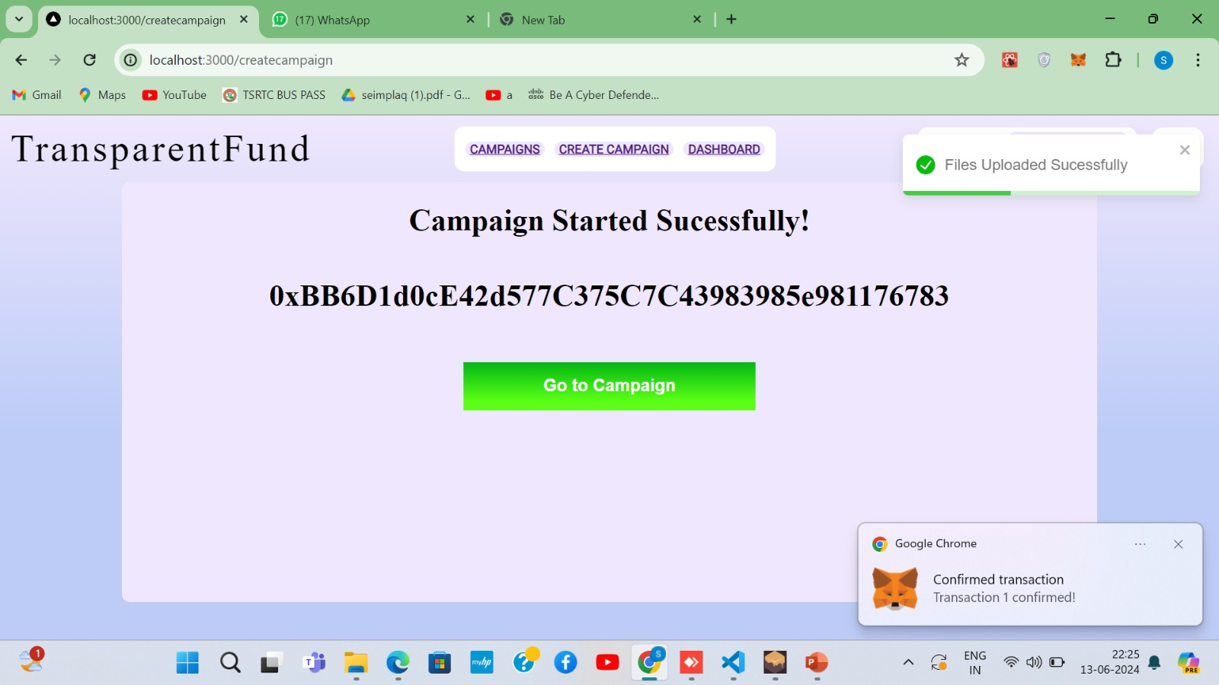
CAMPAIGN CREATED SUCESSFULLY

Slide 23
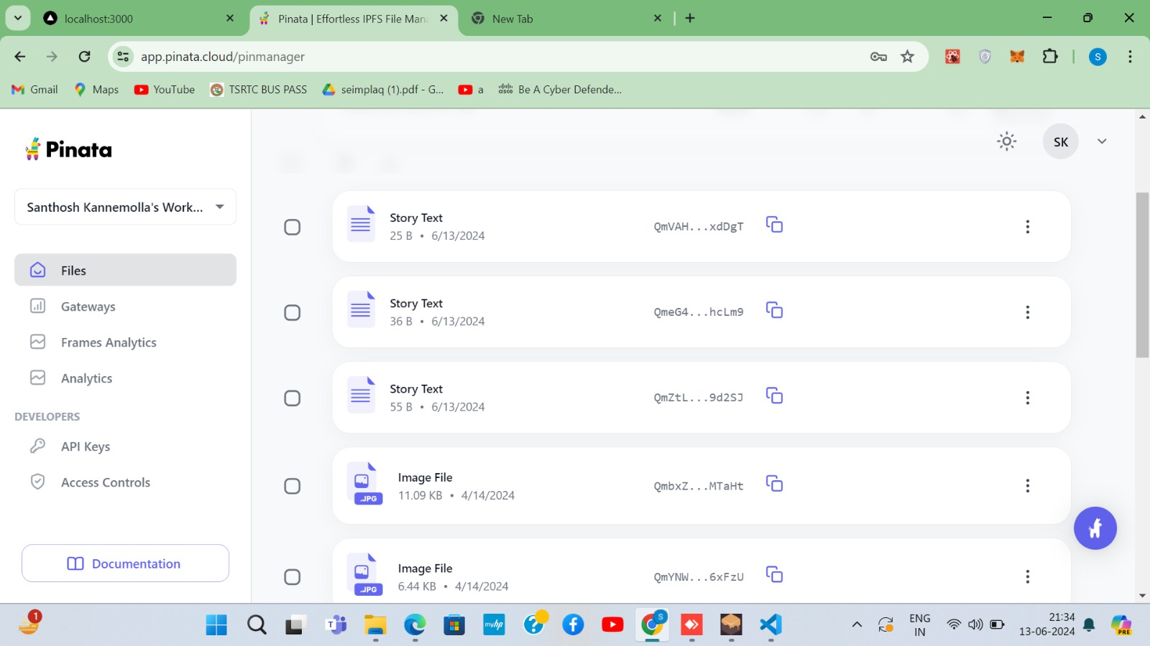
IPFS PINATA CLOUD

Slide 24
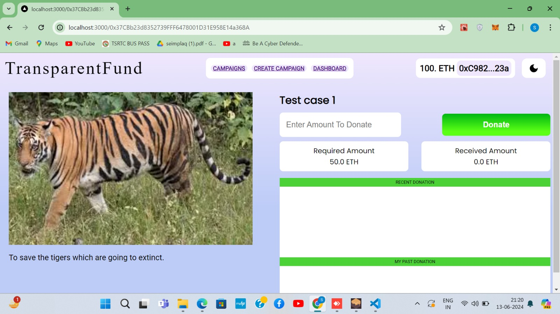
INTO THE CAMPAIGN

Slide 25
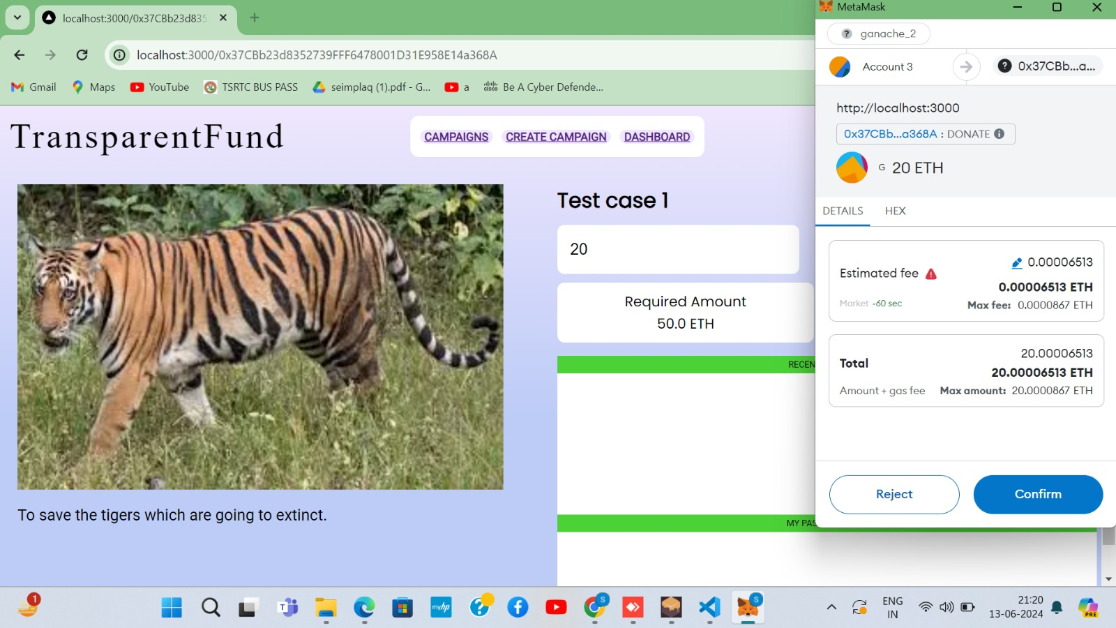
DONATE TO THE CAMPAIGN

Slide 26
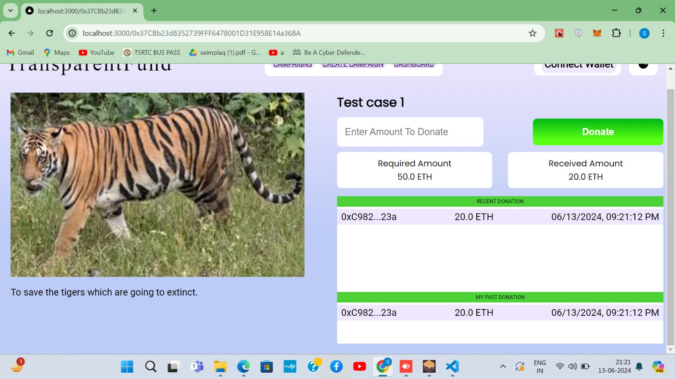
TRANSACTION STATUS

Slide 27
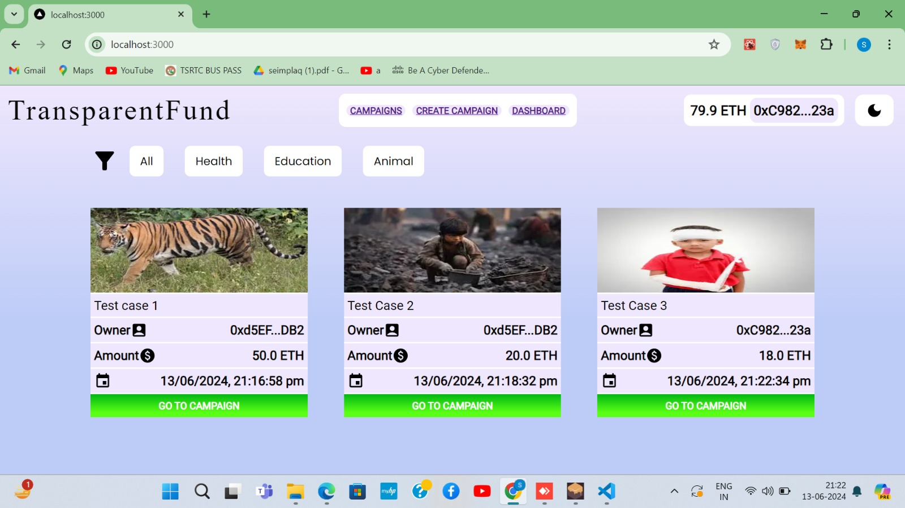
ALL CAMPAIGNS

Slide 28
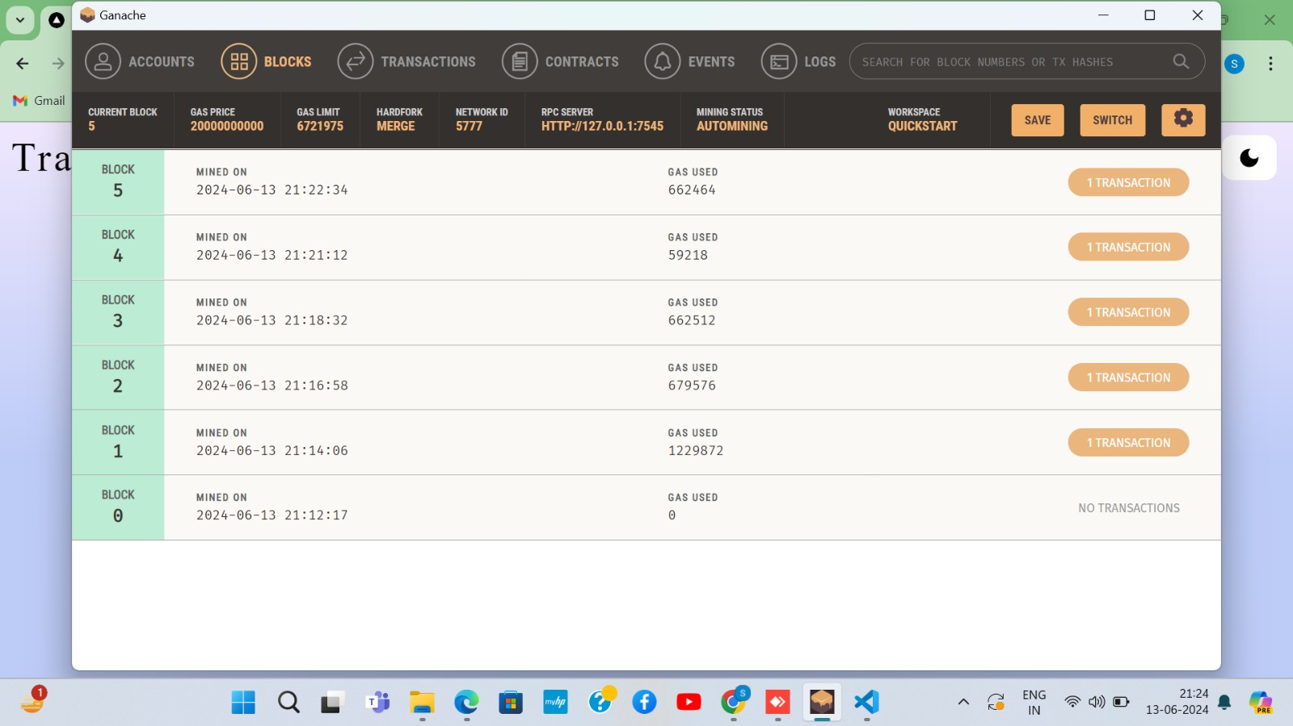
BLOCKS OF TRANSACTIONS

Slide 29
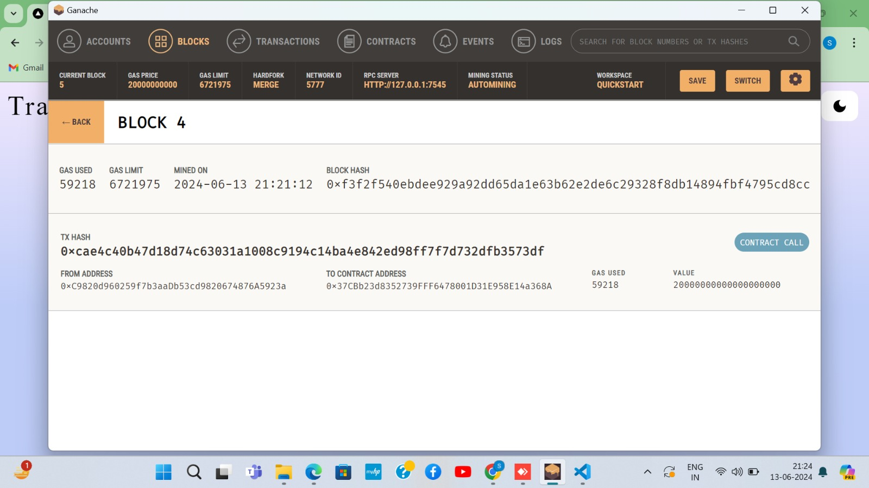
BLOCK DETAILS

Slide 30
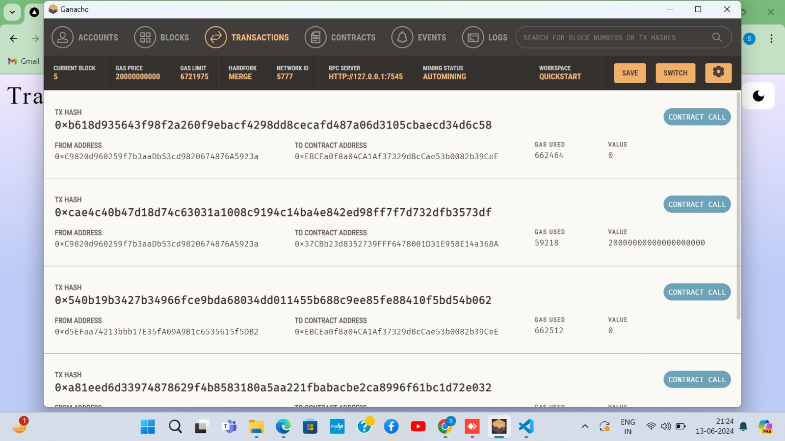
LIST OF TRANSACTION

Slide 31
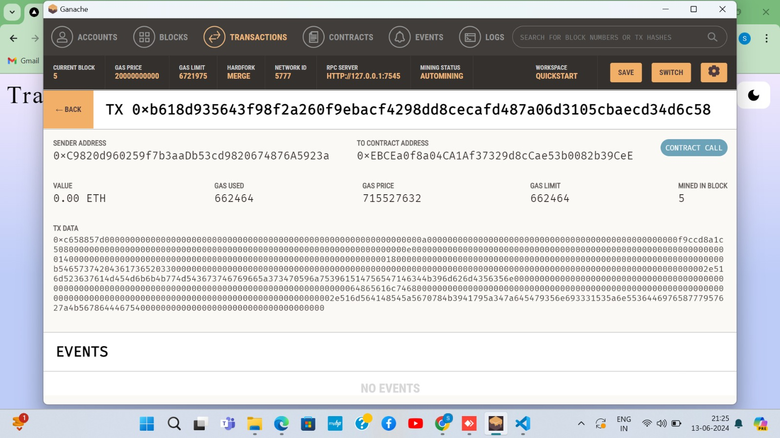
TRANSACTION INFORMATION

Slide 32



APPLICATIONS
Secure and Transparent Transactions
Non-profit and Charitable Organizations
Investment Opportunities
Global Accessibility

Slide 33
CONCLUSION
Conventional crowdfunding methods have long suffered from lack of transparency and fraud. It is an avoidable problem, and we believe that we have implemented a solid solution that can do away with these long-standing problems. The aim to have a transparent, decentralized platform has been achieved to a great extent. This project has covered the weak points of general crowdfunding platforms to provide transparency to the process of crowdfunding and build trust among people, so that they may contribute their wealth to good causes without fear of fraud

Slide 34
REFERENCES
[1] Building a Blockchain-Based Decentralized Crowdfunding Platform for Social and Educational Causes in the Context of Sustainable Development 2023, 15(23), 16205; https://doi.org/10.3390/su152316205.MDPI
[2] Bhaskar, P., & Mehrotra, S. (2020). Blockchain Technology and Crowdfunding: A Systematic Review. In 2020 2nd International Conference on Innovative Mechanisms for Industry Applications (ICIMIA) (pp. 1-5). IEEE.
[3] Zhang, W., Zheng, Z., & Cai, Z. (2020). Crowdfunding based on Blockchain: A Comprehensive Review. Journal of Industrial Information Integration, 20, 100155
[4] Xu, J., Wu, J., & Dai, J. (2019). Blockchain-based decentralized crowdfunding: A survey. arXiv preprint arXiv:1908.01897.
[5] Gai, K., & Qiu, M. (2019). Blockchain-based crowdfunding: Challenges and opportunities. Electronic Commerce Research and Applications, 34, 100833.
[6] Malithi mithsara, T M K,(2020)Blockchain-based Distributed Secure Crowdfunding and Decision-Making Platform for Large-scale Business Projects in Public and Private Sectors. ResearchGate
[7] Chethan S, Rohan P, Roopashree CS,(2023) Crowdfunding Dapp .IRJMETS
[8] Dipali Pawar, Sanket Sangle, Aditya Muley,Siddhesh, Ruhinaaz Shaikh (2023) Blockchain based Crowdfunding using Ethereum Smart Contract.IJRASET
[9] Vinita ,Sam , Ravi (2023) A Transparent , Distributed & Secure Crowdfunding platform based on Blockchain.Springer

Slide 35

THANK
YOU

